Slide 1
Timeline
DATE | TOPICS | RELATED TOPIC
05/5/2025 – 09/5/2025 | Basic transformations: Negative, Power Law, Log, Piecewise Linear stretching, Thresholding. Histogram analysis: Histogram Equalization, Histogram Matching, Contrast Local Adaptive Histogram Equalization. | Basic transformations & Histogram analysis
12/5/2025 - 16/5/2025 | Correlation and Convolution, Box filter, Gaussian Filter, Median filter. Resize images, Nearest Neighbor Interpolation, Linear Interpolation, Bilinear Interpolation. | Fundamentals of Spatial filtering
19/5/2025 – 21/5/2025 22/5/2025 – 23/5/2025 | Sobel filter: Derivative in detecting edge, Gradient, Sensitivity of derivatives to noise, Sobel Filter Program Bilateral filter: Compare Bilateral Filter and Gaussian Filter, My implementation program | Sobel filter Bilateral filter
26/5/2025 – 28/5/2025 29/5/2025 – 30/5/2025 | Canny edge detecting: Gradient, Non-Maximum Suppression, Hysteresis threshold, My implementation program Morphological Image Processing: Dilation, Erosion, Opening, Closing | Canny edge detecting, Morphological Image Processing
02/6/2025 – 04/6/2025 | Morphological Image Processing: Hit or miss transform, Boundary Extraction, Thinning, Skeleton. | Morphological Image Processing
04/6/2025 – 06/06/2025 | Thresholding | Thresholding

Slide 2
THRESHOLDING

Slide 3

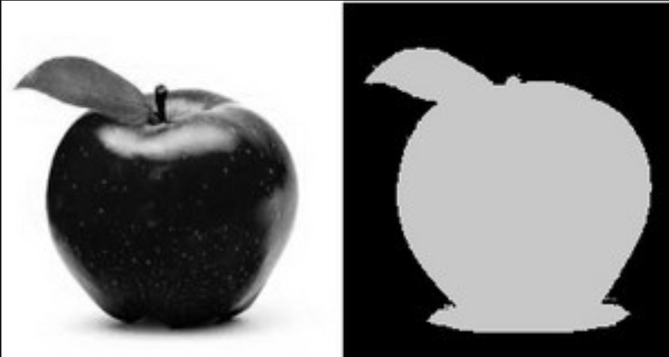
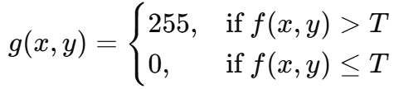
Introduction
Thresholding is a simple but important image segmentation technique used to separate objects from the background by converting grayscale images into binary or segmented forms based on pixel intensity.
Basic Thresholding Formula:
f(x, y) : Original pixel value
T : Threshold value
g(x, y) : Output pixel value after thresholding
Original Image
Thresholded Image
Notes:
Là một kỹ thuật phân đoạn ảnh (image segmentation) đơn giản nhưng rất hiệu quả, dùng để phân chia ảnh mức xám thành các vùng dựa trên giá trị độ sáng (intensity).

Slide 4
TABLE OF CONTENT
01
GLOBAL THRESHOLD
02
ADAPTIVE (LOCAL) THRESHOLD
Notes:
“Here’s the roadmap for this talk. We’ll start with basic transformations, then move into histogram analysis. After that, we’ll conclude with key takeaways and applications.”

Slide 5
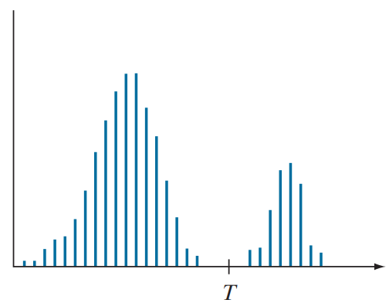
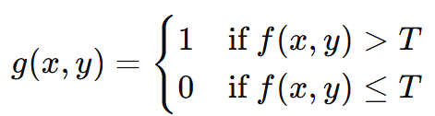
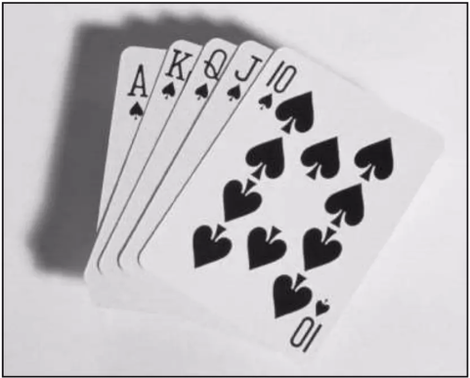
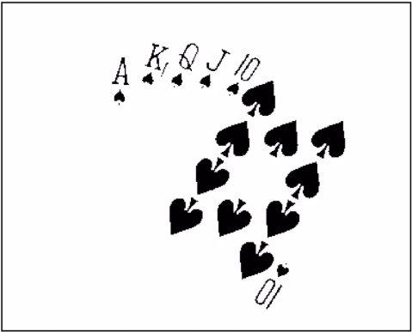
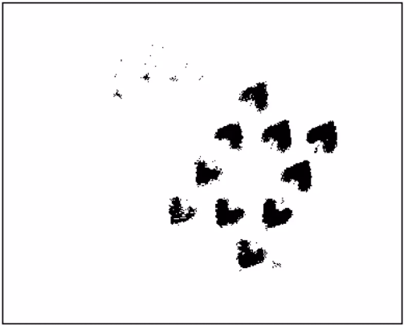
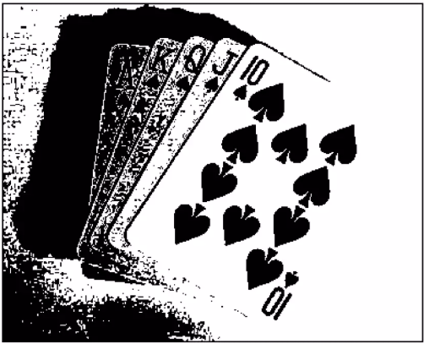
1. Global Threshold
Global Threshold:
Applies the same threshold T to all pixels in the image.
Eg. Converts grayscale image to binary using:
Become dark
Become white
1
0
T
Histogram of original image
Intensity of thresholded image
Original Image
Thresholded Image
Threshold too low
Threshold too high
Notes:
Global Thresholding uses a single threshold value T across the entire image. If a pixel's intensity is above T, it becomes white (1); otherwise, it's black (0).
If you get the threshold wrong, the results can be disastrous
Bên dưới là một ví dụ áp dụng threshold. Chúng tra có ảnh gốc ở đây. Khi ta áp dụng cắt ngưỡng kết qua ta sẽ thu được các vùng có màu đen và các vùng còn lại màu trắng. Tuy nhiên, chúng ta phải chú ý rằng chất lượng của ảnh kết quả phụ thuộc hoàn toàn vào ngưỡng T. Nếu ta chọn T có giá trị tốt thì ảnh kết quả của chúng ta sẽ chất lượng. Còn ta chọn T mà không đúng theo ảnh của mình thì nó sẽ ảnh hưởng đến chất lượng đầu ra của ảnh. Khi chúng ta chọn ngưỡng quá thấp ảnh sẽ bị mất một số thông tin như hình này. còn khi chọn ảnh quá cao ảnh kết quả sẽ thế này. Giá trị của T tốt nhất để thresholding là nằm giữa hai đỉnh của histogram, vì đó là vị trí tối ưu để phân tách pixel thuộc về nền và vật thể. Tại điểm giữa, sự nhầm lẫn giữa hai lớp là thấp nhất, giúp tách đối tượng ra khỏi nền một cách chính xác nhất.“ Tuy nhiên histogram của một ảnh không phải lúc nào cũng rõ rang các đỉnh. Hình dáng của histogram bị ảnh hưởng bởi một số yếu tố đặc biệt là nhiễu và ánh sáng.

Slide 6
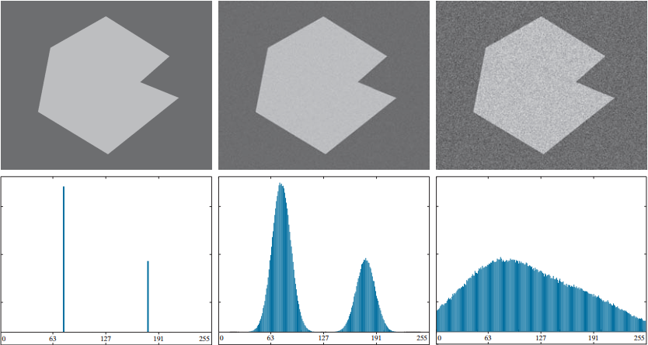
The role of Noise
Noiseless image
Gaussian noise standard deviation of
10 intensity levels.
Gaussian noise standard deviation of
50 intensity levels.

Slide 7
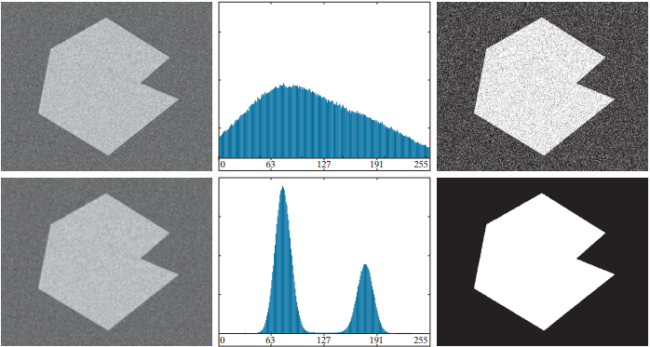
The role of Noise
Noise image
Histogram
Result using threshold

Slide 8
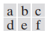
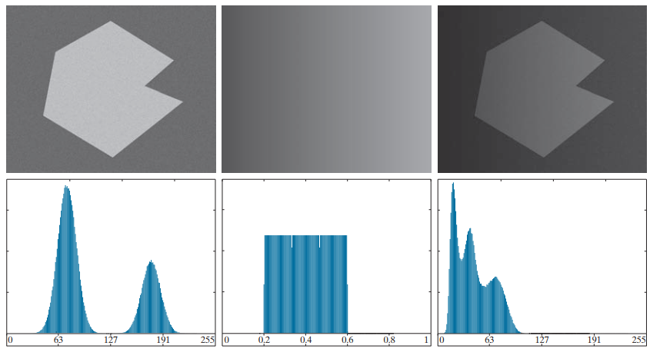
The role of Illumination
Intensity ramp in the
range [0.2, 0.6]
Product of (a) and (b)
Noisy image
Notes:
Figure 10.34(a) is the noisy image

Slide 9
Basic Global Thresholding Methods
Manual Thresholding
The user manually selects a threshold value T
Simple to apply but not optimal for complex histograms.
Auto Thresholding
Iterative Selection Thresholding
Otsu method

Slide 10
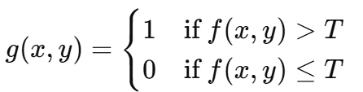
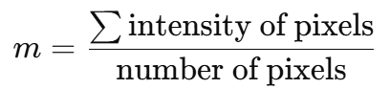
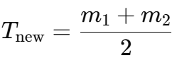
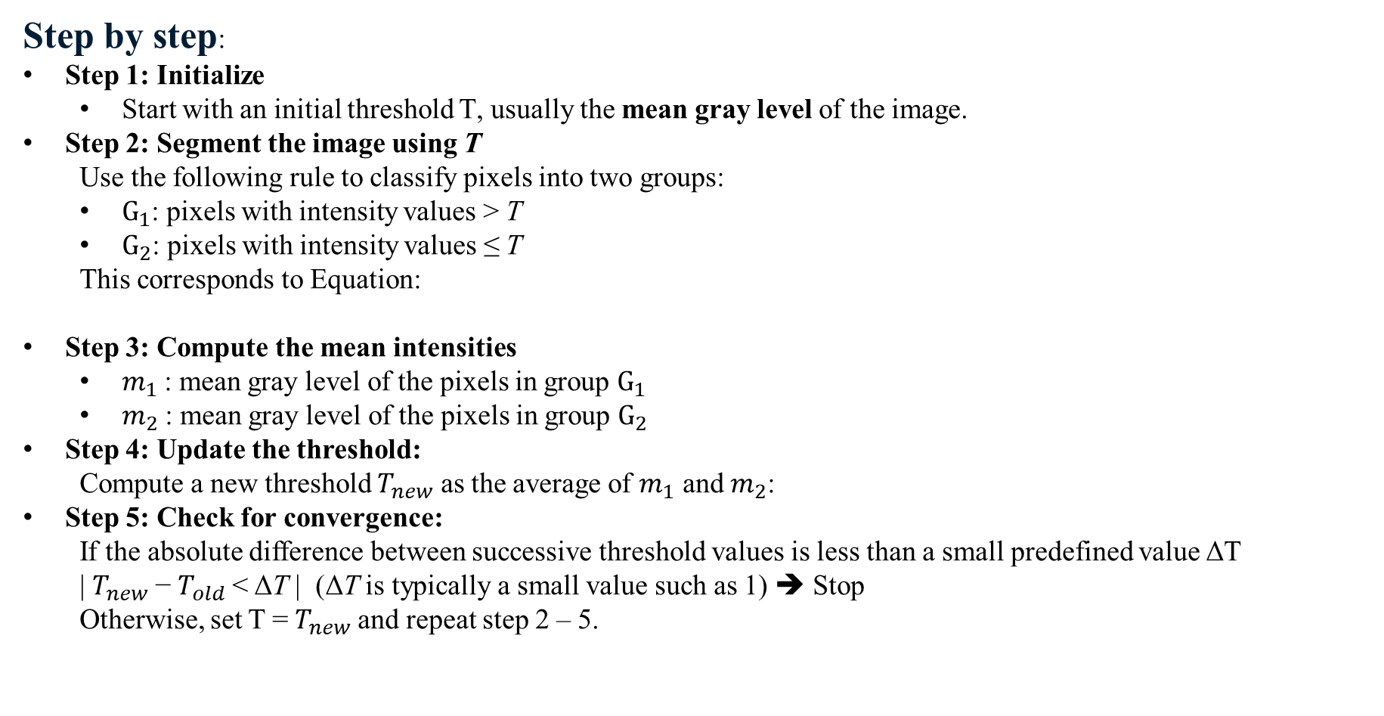
Iterative Selection Thresholding
Objective:
To automatically determine a global threshold T by iteratively refining the value until it stabilizes.
Step by step:
Step 1: Initialize
Start with an initial threshold T​, usually the mean gray level of the image.
Step 2: Segment the image using T
Use the following rule to classify pixels into two groups:
$G_{1}$​: pixels with intensity values > T
$G_{2}$​: pixels with intensity values ≤ T
This corresponds to Equation:
Step 3: Compute the mean intensities
$m_{1}$​: mean gray level of the pixels in group $G_{1}$​
$m_{2}$​: mean gray level of the pixels in group $G_{2}$
Step 4: Update the threshold:
Compute a new threshold $T_{new}$​ as the average of $m_{1}$​ and $m_{2}$​:
Step 5: Check for convergence:
If the absolute difference between successive threshold values is less than a small predefined value ΔT
| $T_{new}$​− $T_{old}$< ΔT | (ΔT is typically a small value such as 1) ➔ Stop
Otherwise, set T = $T_{new}$and repeat step 2 – 5.

Slide 11
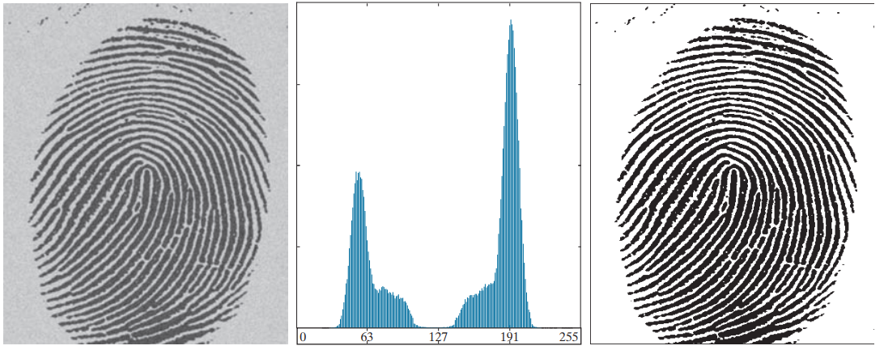
Iterative Selection Thresholding
The algorithm works well in situations where there is a reasonably clear valley between the modes of the histogram related to objects and background.
Noisy fingerprint
Histogram
Thresholded image
The result of the Iterative Selection Thresholding algorithm is T = 125.4.
The result was obtained after 3 iterations, starting with T equal to the average intensity of the image, and using ΔT = 0.
The result obtained using T = 125
Notes:
Thuật toán Iterative Selection Thresholding hoạt động hiệu quả trong trường hợp này vì histogram có hai đỉnh phân biệt rõ ràng và thung lũng nằm giữa.

Slide 12
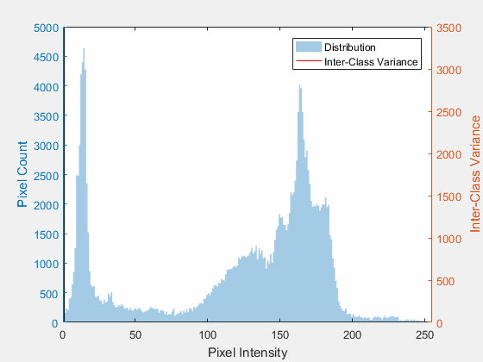
OTSU’S METHOD
Objective: To find the optimal threshold value based on histogram by maximizing the between-class variance.
Between-Class Variance a statistical measure used to evaluate how well two classes (groups of pixels) are separated in an image based on a threshold.
It measures the difference between the mean intensities of the two pixel classes:
Class 1: pixels with intensity ≤ threshold
Class 2: pixels with intensity > threshold
A high between-class variance means the two classes are well-separated, which is desirable in image segmentation.
A low between-class variance means the classes are similar and not well-separated

Slide 13
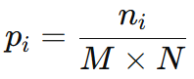
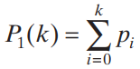
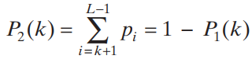
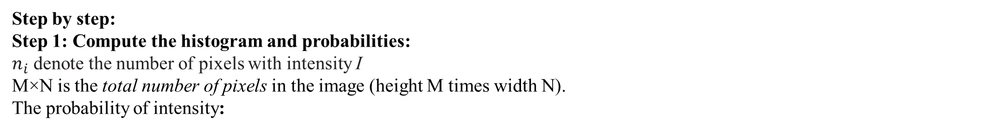
OTSU’S METHOD
Step by step:
Step 1: Compute the histogram and probabilities:
$n_{i}$ denote the number of pixels with intensity I
M×N is the total number of pixels in the image (height M times width N). The probability of intensity:
Step 2: Choose an initial threshold value k (any value k ≥ 0)
This threshold will be used to separate the pixels into two classes:
Class 1 (background): pixels with intensity ≤ k
Class 2 (foreground): pixels with intensity > k
Step 3: Calculate the cumulative probabilities of the two classes
For the chosen threshold k, calculate the cumulative probabilities (class probabilities) for each group:
Probability of class 1 - background:
Probability of class 2 - foreground:

Slide 14
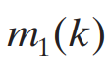
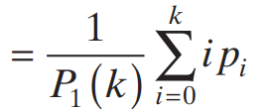
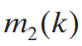
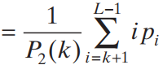
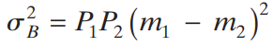
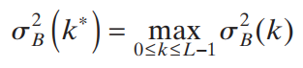
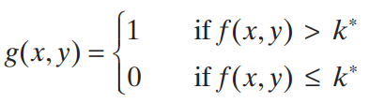
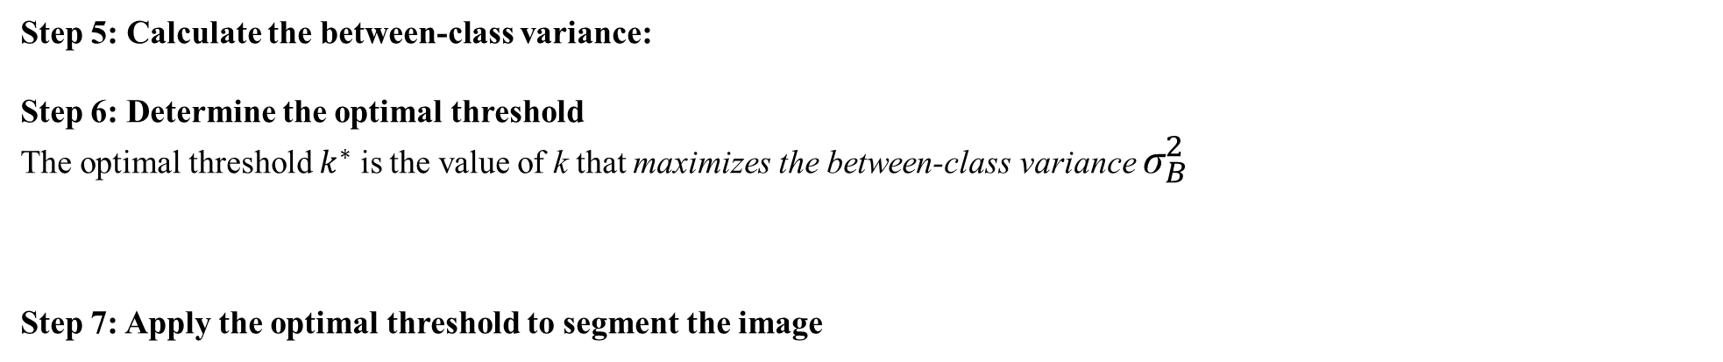
OTSU’S METHOD
Step 4: Calculate the mean intensity values of the pixels in both classes
The mean intensity value of the pixels in Class 1:
The mean intensity value of the pixels in Class 2:
Step 5: Calculate the between-class variance:
Step 6: Determine the optimal threshold
The optimal threshold $k^{∗}$ is the value of k that maximizes the between-class variance ${\text{σ}}_{B}^{2}$
Step 7: Apply the optimal threshold to segment the image

Slide 15
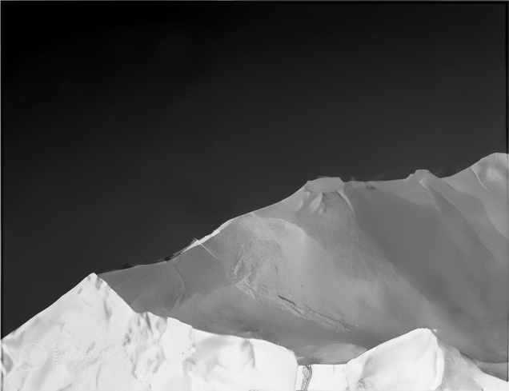

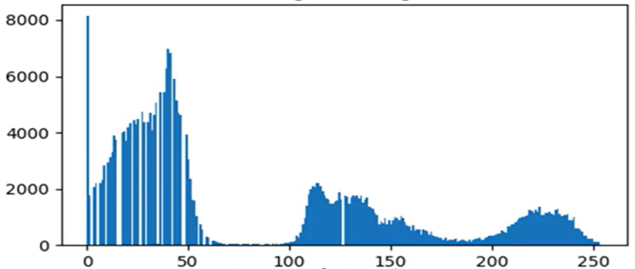
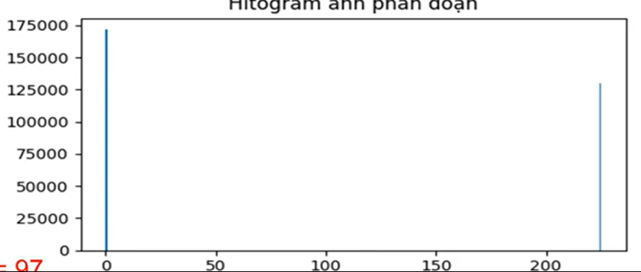
OTSU’S METHOD
Otsu’s Threshold
Optimal threshold value = 96
Original Image
Thresholded Image by Otsu’s method
Histogram of Original Image
Histogram of Thresholded Image by Otsu method

Slide 16
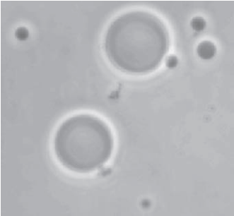
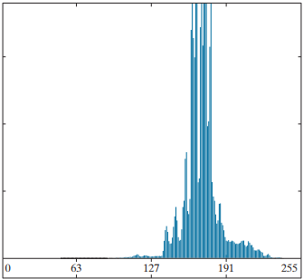


Compare Iterative Selection Thresholding and Otsu’s Thresholding
Original image
Histogram
Iterative Selection Thresholding
result
Otsu’s Thresholding result

Slide 17
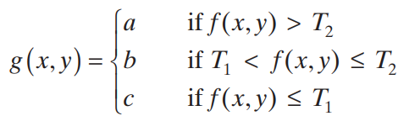
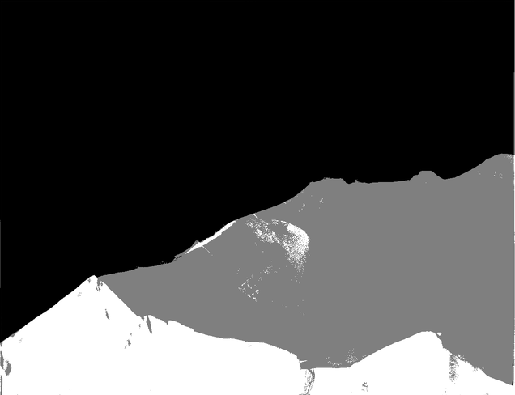
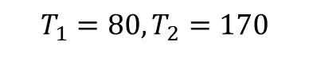
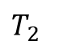
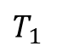
Multi threshold
Multi threshold: using two or more threshold values
$$T_{1}$$
$$T_{2}$$
Segment the image into three regions, assigning intensity levels a, b, and c to each region respectively
Multi thresholding
$$T_{1}=80,T_{2}=170$$

Slide 18
Types of Thresholding in OpenCV
Type | Description | OpenCV Flag
Binary | Pixel > T → 255; otherwise 0 | THRESH_BINARY
Binary Inv | Pixel > T → 0; otherwise 255 | THRESH_BINARY_INV
Truncate | Pixel > T → T; otherwise unchanged | THRESH_TRUNC
To Zero | Pixel ≤ T → 0; otherwise unchanged | THRESH_TOZERO
To Zero Inv | Pixel > T → 0; otherwise unchanged | THRESH_TOZERO_INV

Slide 19
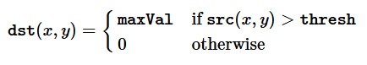
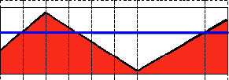

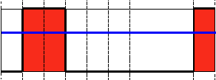
Threshold Binary
This thresholding operation can be expressed as:
If the intensity of the pixel src(x, y) is higher than thresh, then the new pixel intensity is set to a MaxVal.
Otherwise, the pixels are set to 0.
Original Image
Thresholded Image

Slide 20
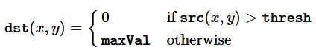
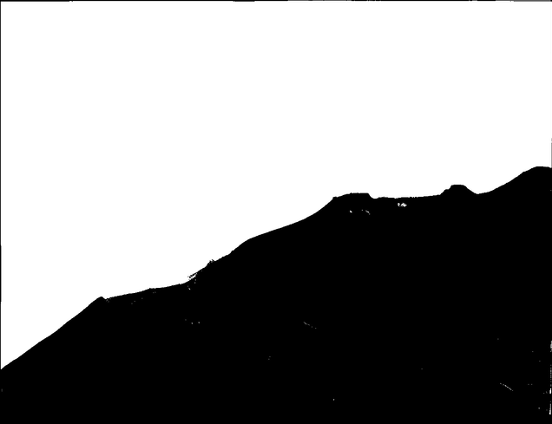
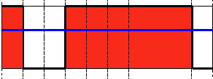
Threshold Binary, Inverted
This thresholding operation can be expressed as:
If the intensity of the pixel src(x, y) is higher than thresh, then the new pixel intensity is set to a 0.
Otherwise, the pixels are set to MaxVal.
Original Image
Thresholded Image

Slide 21
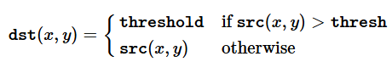

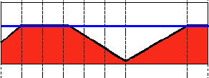
Truncate
This thresholding operation can be expressed as:
The maximum intensity value for the pixels is thresh, if src(x, y) is greater, then its value is truncated.
Original Image
Thresholded Image

Slide 22
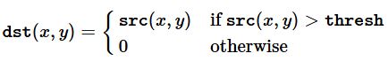
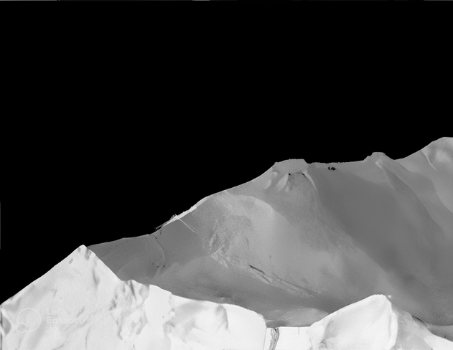

Threshold to Zero
This thresholding operation can be expressed as:
If src(x, y) is lower than thresh, the new pixel value will be set to 0.
Original Image
Thresholded Image

Slide 23



Threshold to Zero, Inverted
This thresholding operation can be expressed as:
If src(x, y) is greater than thresh, the new pixel value will be set to 0.
Original Image
Thresholded Image

Slide 24



Why Adaptive Threshold
Global thresholding uses a single value for the entire image. This fails when lighting is uneven. Adaptive thresholding solves this by computing thresholds locally.
Text image corrupted by
sinusoidal shadin
Result of global thresholding
using Otsu’s method
Result of local thresholding

Slide 25


What is Adaptive Thresholding?
For each pixel, a window around it is selected. The pixel value is compared to a threshold computed from the window's values. If it's greater, the pixel is set to 255; otherwise, 0.
Neighborhood size is defined by blockSize (an odd integer).
Notes:
For each pixel, a window around it is selected. The pixel value is compared to a threshold computed from the window's values. If it's greater, the pixel is set to 255; otherwise, 0.

Slide 26


Adaptive Mean Thresholding
For each pixel , the threshold is computed based on the average intensity of the surrounding pixels in a window.
In many cases, the computed local mean is very close to the actual pixel intensity.
Subtracting slightly lowers the threshold to ensure that meaningful foreground details (like text or edges) are captured.
This allows brighter foreground objects to be correctly classified as white, enhancing contrast and detail.

Slide 27



Adaptive Gaussian Thresholding
Similar to Mean, but applies a Gaussian weighting to the neighborhood
Pixels closer to the center have higher influence

Slide 28




Compare adaptive thresholding methods
Original Image
Global Thresholding
T = 127
Adaptive mean thresholding
Adaptive gauss thresholding

Slide 29




Compare adaptive thresholding methods
Original Image
Global
Otsu’ Thresholding
Adaptive mean thresholding
Adaptive gauss thresholding

Slide 30


Triangle threshold
Triangle thresholding is an automatic thresholding method based on the geometric shape of the histogram.
Use Triangle Thresholding when:
Performs effectively when the image histogram is not bimodal, unlike Otsu's method.
Effective when foreground is much smaller or larger than the background.
Core Idea:
Find the peak (maximum value in the histogram).
Identify the end point of the histogram — either the leftmost or rightmost non-zero value.
Draw a line between the histogram peak and the end point.
For every value between the peak and the end: Calculate the perpendicular distance from the histogram point to the line.
The threshold is the point with the maximum perpendicular distance.
Visually, this forms a triangle between the histogram peak and one end — the threshold is the point furthest from the triangle’s base.
Notes:
The Triangle Thresholding method works by analyzing the histogram of a grayscale image. First, it identifies the peak of the histogram—the value with the highest frequency. Then, it locates one end of the histogram (either the leftmost or rightmost non-zero value). A straight line is drawn from the peak to this endpoint. For each point between the peak and the end, the perpendicular distance from the histogram value to the line is calculated. The threshold is chosen as the point with the maximum distance. This creates a triangle shape in the histogram, and the optimal threshold lies at the point farthest from the triangle’s base.

Slide 31



Triangle threshold
Original Image
Histogram of Original Image
Otsu’s thresholding
Triangle thresholding

Slide 32
SPACTIAL FILLTERING
Window
Window
Window
Image f
Image f
Image f
Notes:
A filter kernel is a matrix that have size 3x3, 4x4, etc

